Slide 1

Subversion
Can’t we all just get along?

Slide 2

Overview
Why Source Control?
History
Basics
Advanced Features
Cash Cab Tucson

Slide 3

Why Source Control?
Because we make mistakes
Control-Z only goes so far…
Keep copies of things in the past in a logical fashion
Try breaking change concepts in a safe fashion

Slide 4

Where do version controls systems come from?
RVS
locking system (same as SourceSafe)
CVS- built on top of RVS
Built on top of RVS
Non locking
had some problems
SVN
Locks optional
generally non-locking

Slide 5
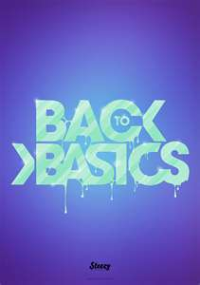
All it does
Gets files
Adds files
Merge files
Moves files
Organize files

Slide 6

Under the hood
SVN command line
SVN Server on top of Apache
Tortoise
Anhk SVN
Rocket SVN

Slide 7
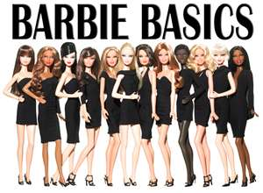
Basic concepts
Server holds the files
Clients downloads to working copy
Works on trees-not files
Has meta data-messages
You have to get-no pushing

Slide 8
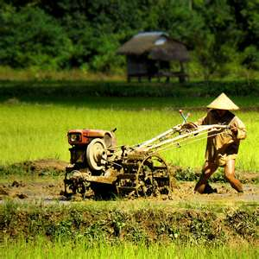
Working copy
Your working copy is the files on your machine
These files come from a node of the svn tree
Working copies can have changes not in the tree
When you commit you create a new revision(tree)
Working copies can moved to different nodes in the tree

Slide 9

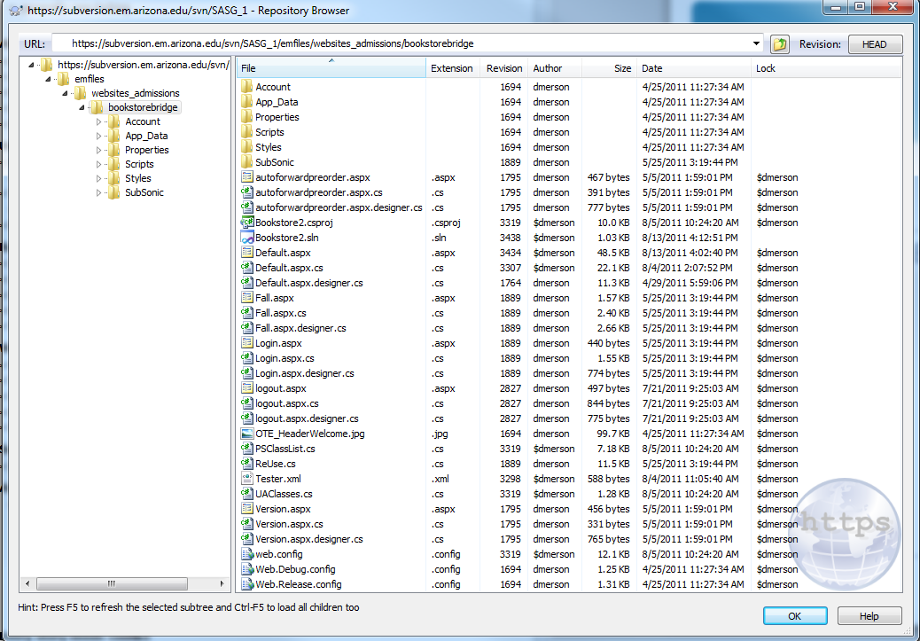
Server Copy
SVN-Repo Browser
Also in VS2010
File->Open
Subversion Project

Slide 10
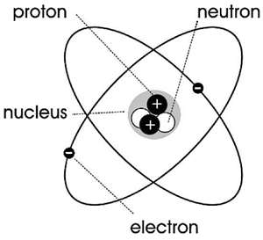
Atomicity
Commits all files or nothing
Peter checks out one.cs, two.cs, three.cs
Paul checks out two.cs
Paul commits two.cs
Peter commits his 3 files
Subversion says no
Peter can commit one and three
Needs to merge two

Slide 11

Every story needs conflict
If you try to check in and SVN cannot merge
Makes you get latest version and merge
<<<< mine
>>>> r<number>
Let’s look at an example

Slide 12


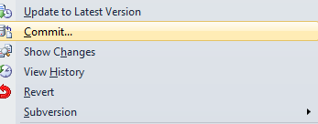
Hello Real World Example
Create a new app and put in SVN
Of course, it should be “Hello World”
You change and commit it

Slide 13


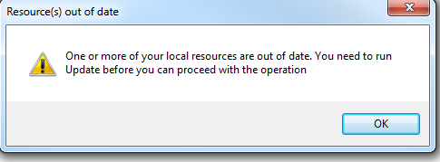
In another room
Someone opens your app via SVN and gets latest version
They put in the BallMere version and tries to commit

Slide 14
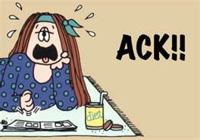
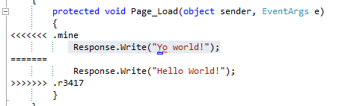
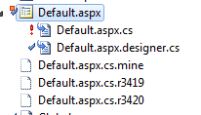
So you get latest with fear
Ack what is happening?????
Creates 2 files-Mine and theirs (latest revision)

Slide 15

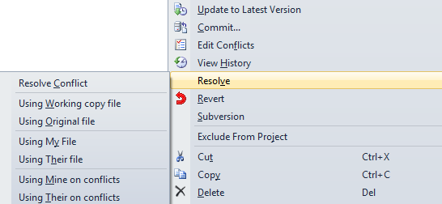
Resolution of the story!

Slide 16

Note the arrows
<<<< means latest
>>>> means earlier
Also note the revision number

Slide 17

What if there is no conflict
If no differences, just creates a new tree!
For example, if you just added another function
SVN just creates a new Revision

Slide 18

Don’t go changing
If two different people create new functions, you will need to resolve
Basically, you would take their conflicts and voila, you have merged the files

Slide 19

The down side is…
None
UpdateToLatestVersion will never destroy your code
It will always save your working copy

Slide 20

Concepts
Trunk
Latest stable (compiles) code
Branch- an offshoot of code
You move code from the trunk to the another place in the branch directory
Do this to work on a new breaking feature without effecting main trunk
Tag
A read only code-released version
We will make some changes here…

Slide 21

Branching, Switching and Merging
Create a new branch
Switch means your working copy is the new branch
Without switch you are still in the trunk
Branch-no switch
Merging
Taking 2 branches and creating a new version with parts of both

Slide 22

Branching out concepts
Each folder has a tree of files that is a version
Branching, merging, switching, tagging and versioning is done from your local machine and moved to the server
You don’t version in the server
Working copy merges changes and then commits
Switch means you branched and now want your working copy to be your current working copy

Slide 23
Visual Guide
SVN Node
Working copy points to SVN Node
Commits go to SVN Node
My code on my HD
(Working Copy)

Slide 24
Branch or Tag
He speaks to me!
I am not getting updates
SVN Node
Branch (or tag)
You are still pointing to the same node, you made a copy to another node
My code on my HD
(Working Copy)

Slide 25
Switch
I am not getting updates
All his attention is on me!
SVN Node
New Node
When you switch, you point at the new node
My code on my HD
(Working Copy)

Slide 26
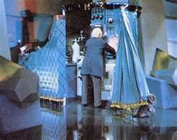
Pay no attention
Patches
Used when user has only read only access
Public projects like SubSonic or Ubuntu
Hookscripts
More advanced item

Slide 27
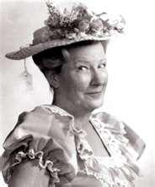
Tags
Tags are frozen by convention
These are versions that are deployed
They don’t change
Example
ScholarshipUniverse
Trunk
Tags
Version 1.0.1
Version 1.0.2

Slide 28

Branches
Branches are working code
They allow you to try stuff that breaks code but doesn’t break trunk
Once branch is finished can merge
Example
ScholarshipUniverse
Student
Trunk
Branch
Experiment
BugFix
TestingVersion1

Slide 29
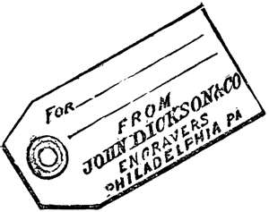
How to use a tag
There is a bug in production
The trunk has untested stuff
You pull down the latest tag to your local machine
You move this into a new branch
You fix the bug
You push this branch to testing
Upon testing complete, you create a new version (tag) and publish it
You merge the new branch into the trunk if necessary

Slide 30

How to use a branch Part 1
You get a new idea for your app but it will break a lot of things
You create a branch and switch to that branch
You give it a try and if it works merge back into the trunk

Slide 31
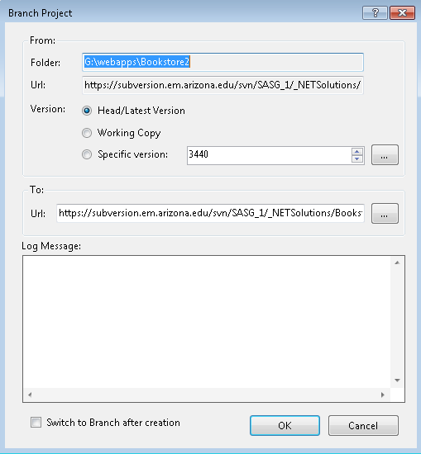

Slide 32
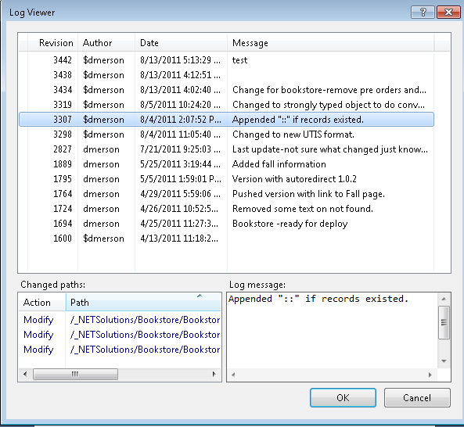

Slide 33
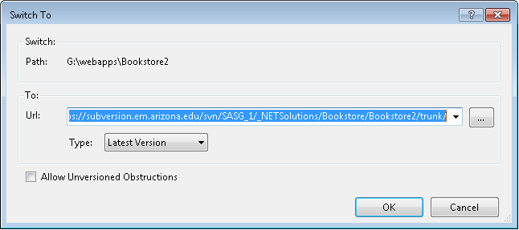
Switch

Slide 34
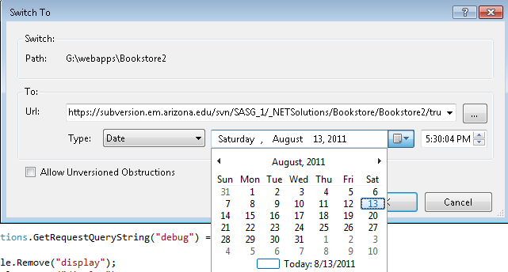
Switch to Date

Slide 35

How to use a branch Part 2
You have some testing coming up but you are still working on code
You create a branch (testing_v1)
You publish from that branch
You do your thing in the trunk
If a bug occurs that could stop testing, you fix the branch
You don’t throw more untested items in mix or things that are broke

Slide 36
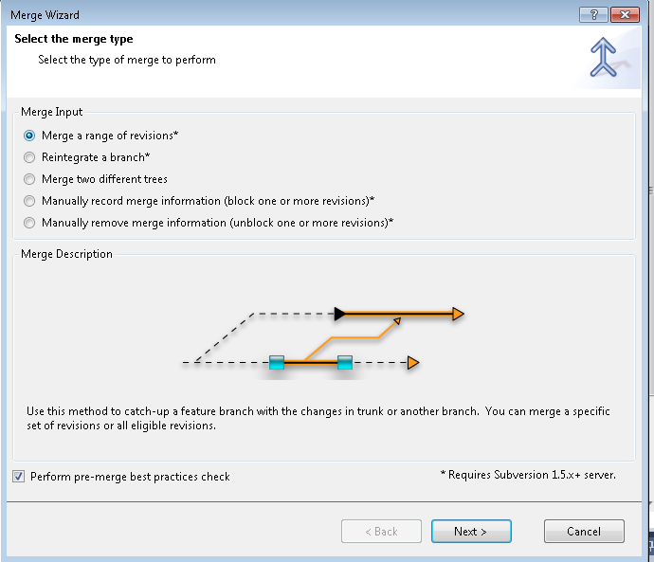
Merges

Slide 37
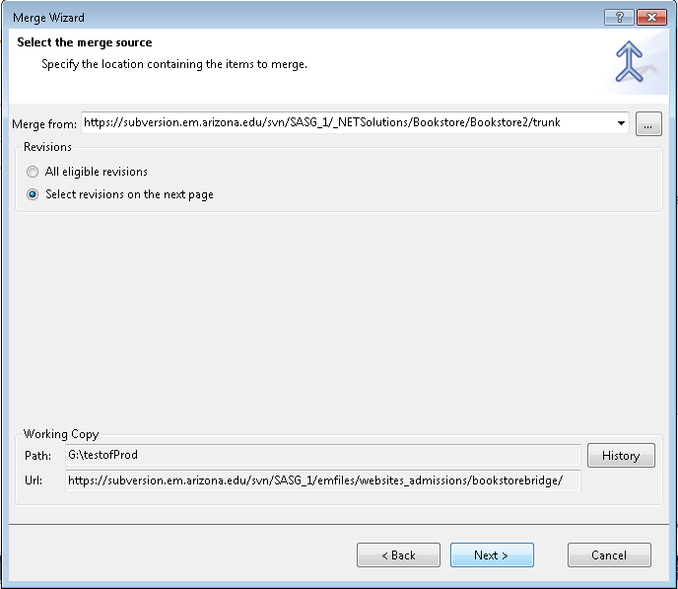

Slide 38
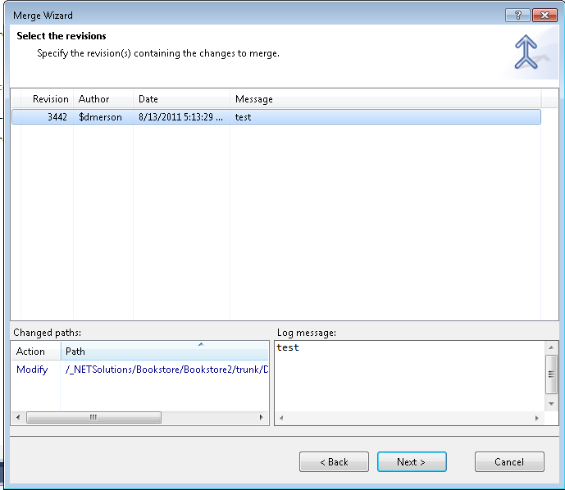

Slide 39
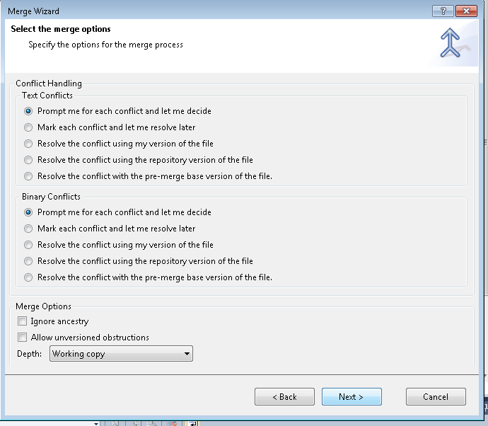
This appears on all merges

Slide 40
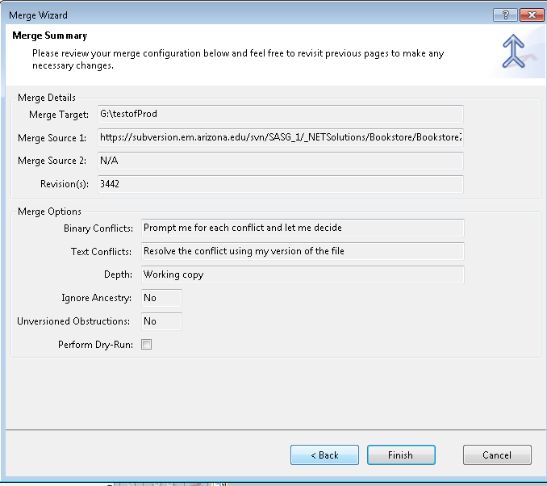
This the last page on all merges

Slide 41
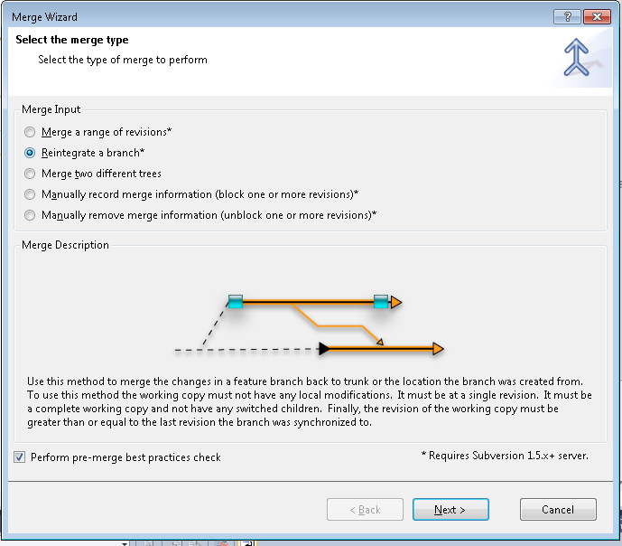

Slide 42
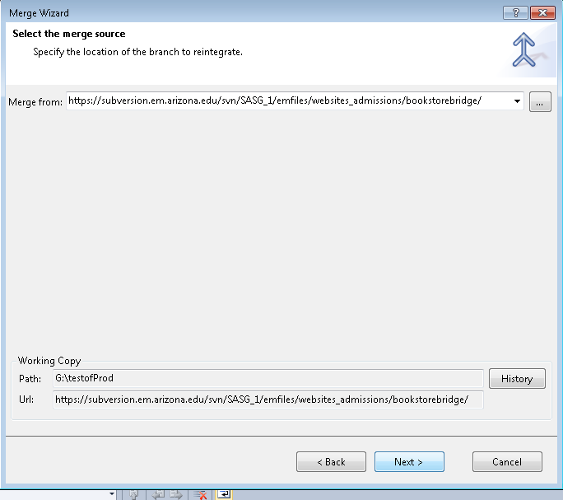

Slide 43
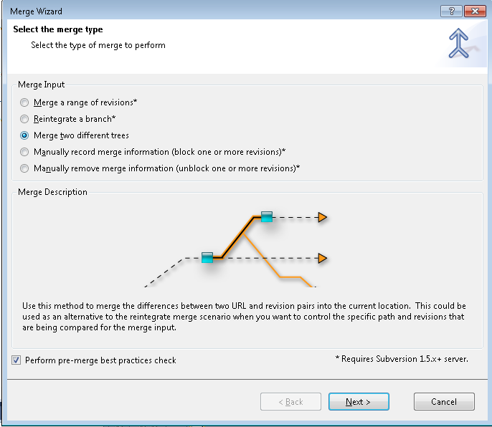

Slide 44
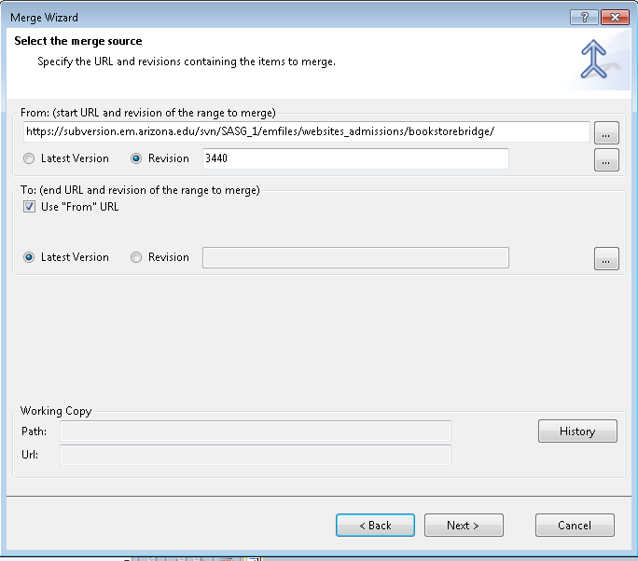

Slide 45

Quick Review
Merge takes from parameter and to parameter
From and To can be a revision(tree) or different path or date
You can select how you want the merge to happen

Slide 46

Can I quote you?
Always comment your code
Every commit!
If you forget what you did use diff techniques
Unified Diff
Compare

Slide 47

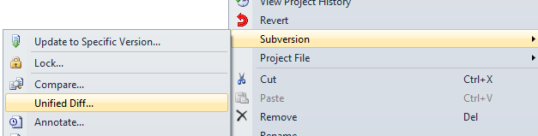
I did what???

Slide 48
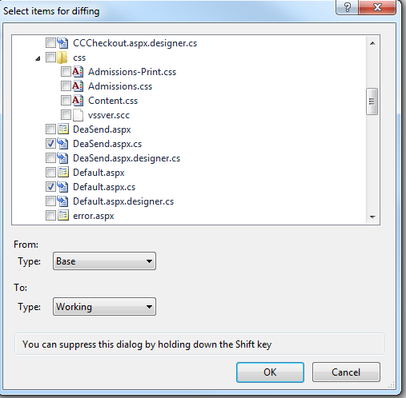
It knows which items have changed
Latest
Yours

Slide 49
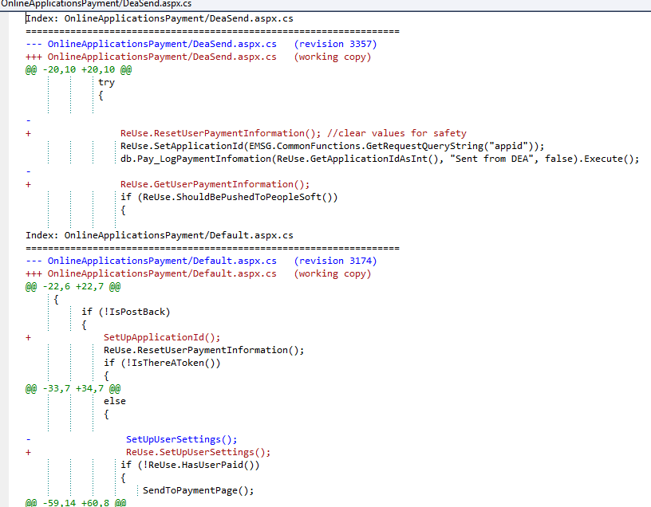
It is color coded
Working copy is red
Revision is blue
Black is the same

Slide 50

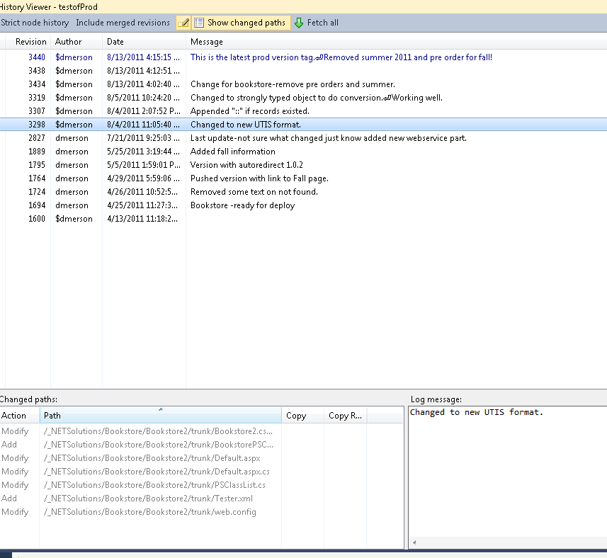
Who dunnit?
View History
Note tree
Not file

Slide 51

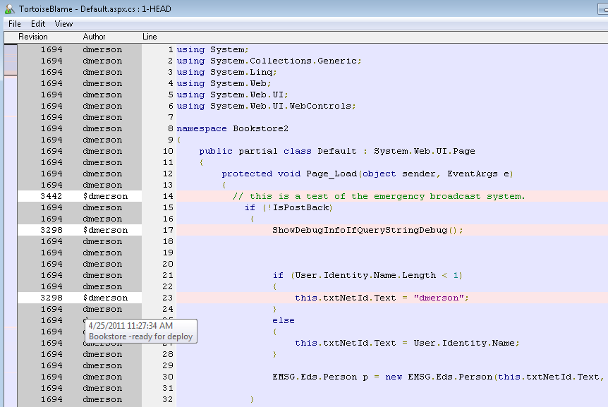
Blame it on Rio

Slide 52

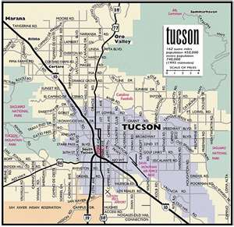
Cash Cab-Tucson
100 dollar level
You have made a feature change, it compiles, what is your next step?
Commit changes with comment

Slide 53

100 dollar level
How can you look at the SVN database?
Repository Browser via Tortoise or Visual Studio

Slide 54


100 dollar level
If your application references external dlls, what must you do to make it compile from SVN?
In VS->show all files->Go to Bin Folder->Include the external dlls.

Slide 55

100 Dollar Level
How do you create a new directory for a new project?
Repository Browser-> Create Folder

Slide 56

Red Light Challenge
Name 4 of the 7 Base levels in SVN Repository.
.NETSolutions
DatabaseSolutions
Common
CodeReview
Personal
MicrosoftSourceSafeArchives

Slide 57

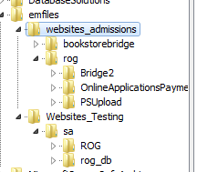
Now a word from our sponsor
New structure for production SVN
Emfiles->same structure as \\em\files\
Should publish compilable solution
This WILL cause redundancy
Should also do a Db snapshot (Haven’t tested)
Example-ROGue and Online Payment in same solution with PSUpload dll will be in multiple places in tree

Slide 58

200 Dollar Level
You committed something an hour ago
You have screwed it up and nothing is working and you want to start over. What command do you want to use?
Revert

Slide 59

200 Dollar Level
You just created a db for a new application, how do you put in Source Control?
Go to Repository Browser
Create folder in DB section
Copy the url to clipboard
Go to Database->Right Click->Link Database to Source Control ->Paste in Url-> OK
Then commit

Slide 60

200 Dollar Level
You are working with others on a project. What is the first command you should use at the beginning of the day?
Update To Latest Version

Slide 61
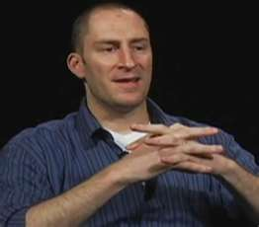
500 Dollar Level
You are ready to commit changes but you forget what all you did
Use UnifiedDiff or Compare

Slide 62

1000 dollar level
You want to try out a feature that will break current code. How should you proceed?
Subversion->Branch->Enter new directory in branches->Click checkbox to switch

Slide 63

1000 Dollar Level
You have finished work on a branch and want to merge it back into the trunk, what do you do?
Go to Project Level
Subversion->Merge
Use second option
Resolve conflict with my changes

Slide 64

2000 Dollar Level
You want to revert to a previous version but don’t want to remove your latest version changes. What do you?
Merge from the previous version into the current trunk
You can do the same thing again to get back to current version

Slide 65

2000 Dollar Level
You have updated a file and someone else has made a change. You want to use your version instead. What command do you use?
Use working copy or use mine

Slide 66

5000 dollar level
You just deployed an application to production. What steps do you take in SVN?
Put it in the new emfiles structure
Go to DB and commit the current state in SS
Then unlink the db

Slide 67

That’s the ride..please leave
What is Source Control?
How did come about?
Why do we use it?
How do we use the various functions

